Slide 1
some simple QM calculation

Slide 2
Optimization
Single point energy
Except some special condition(when you know what are you doing), optimization should be performed before any further calculation. Otherwise the result would be meaningless.

Slide 3

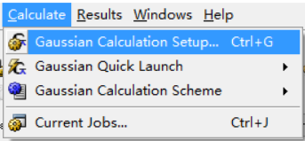
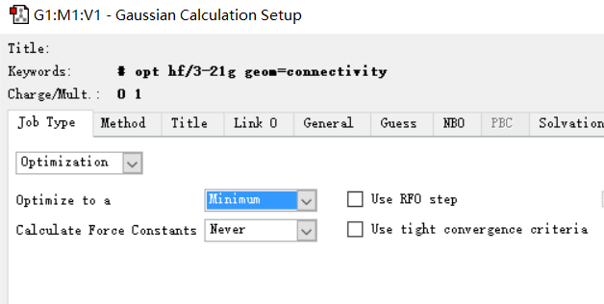
Gaussian: optimization
Gaussian calculation setup
After loading your molecule
Job Type
Optimization
Optimize to a minimum

Slide 4
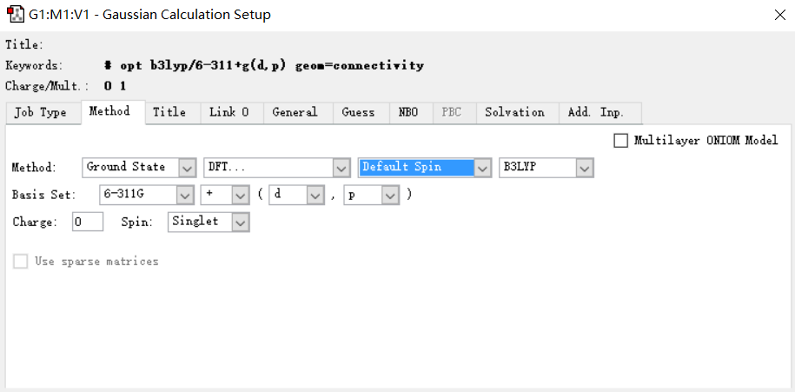
Gaussian: optimization
Basis set
Charge and spin.
Spin = 2 * (number of unpaired electron) + 1
Singlet means spin=1
Doublet means spin=2
For biology system, usually spin=1
Choose your method, usually we will use DFT
Choose your functional. We will change it to m062x by hand later.

Slide 5
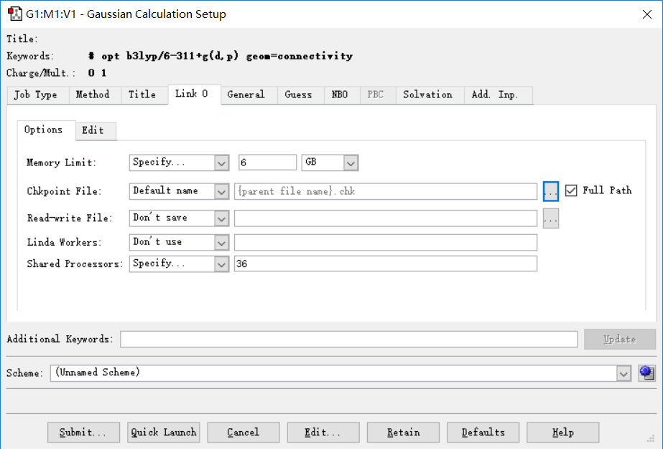
Gaussian: optimization
memory
Check point file
Number of processors used

Slide 6
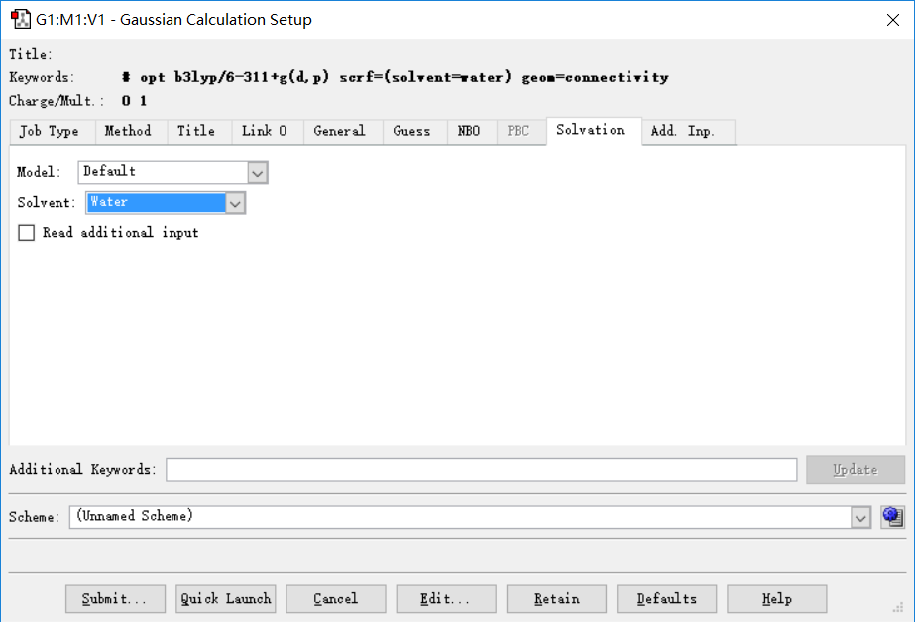
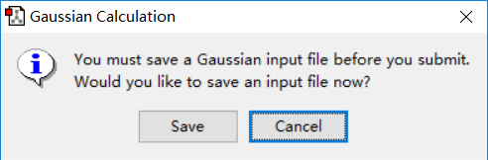
Gaussian: optimization
implicit solvation
Then submit
Save this file, we will edit it so it can be run on hpc2

Slide 7
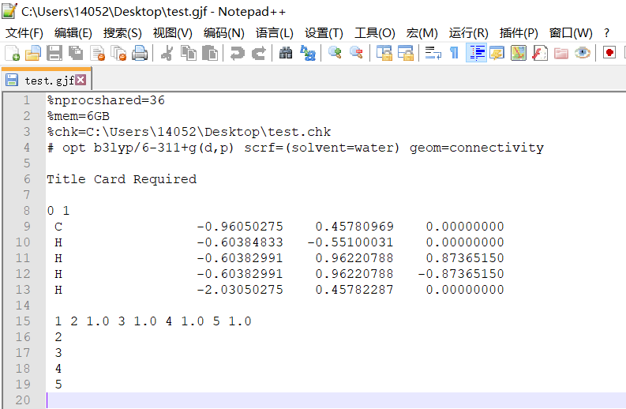
Gaussian: optimization
Number of processors
mem
Change to other functional, e.g: m062x
Of course b3lyp is good, but m062x is better for organic system.
Atom types and coordinates
How these atoms are linked together, in pure QM calculation, these lines will not be used.
Change it to linux format, e.g:
%chk=./test.chk
Number of blank lines between blocks are very important. Gaussian use blank line to determine meaning of each block.

Slide 8

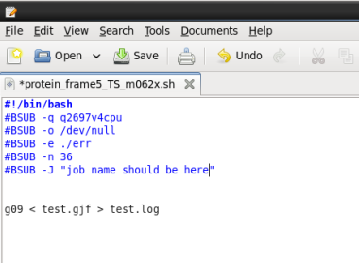
Gaussian: optimization
In hpc2, add these lines to your .bashrc
Script to submit jobs
In a terminal
bsub < test.sh

Slide 9
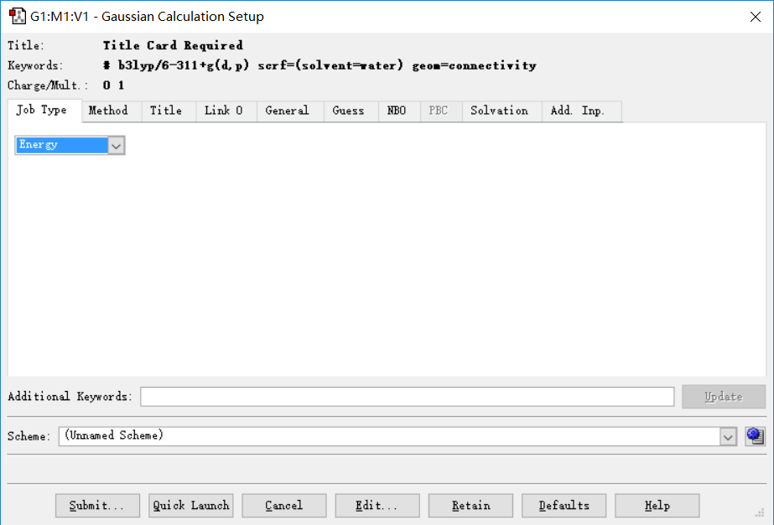
Gaussian: single point energy
In step1, chage the job type to Energy, rest are the same.

Slide 10
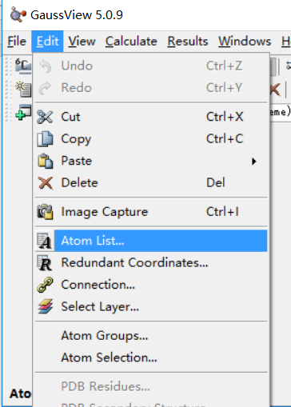
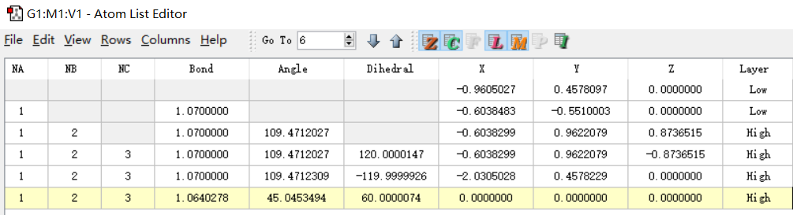
Gaussian: QM/MM
Separate atoms into two layers: high and low.

Slide 11
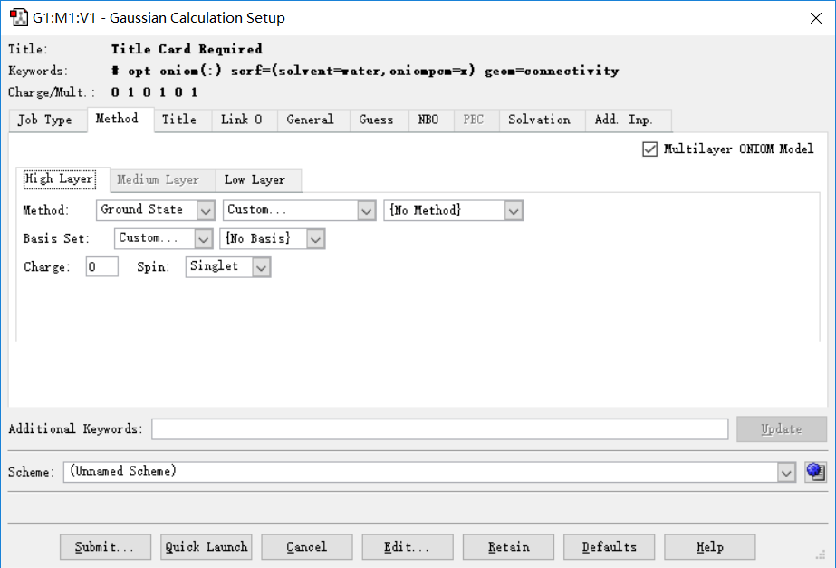
Gaussian: QM/MM
Check~
Define method for each layer.
Rest are the same

Slide 12
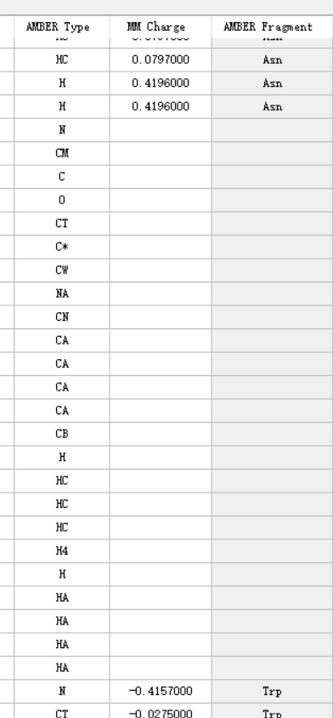
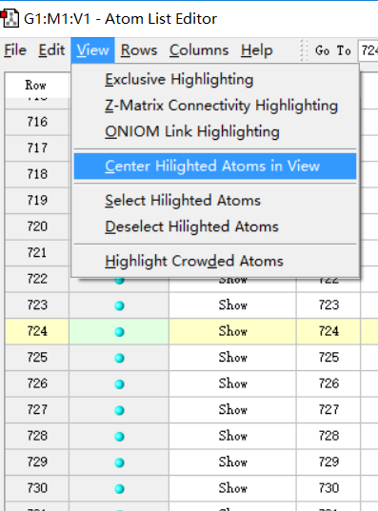
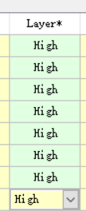
Gaussian: a tip
There are situation that Gaussian can recognize residue(I believe it use bond length to determine if two atoms are linked.)
No MM parameters for these atoms while it’s actually a ordinary amino acid.
Usually, after MD simulation, some bond length are not “perfect”, and gaussian does not cheat it like a bond. We can link these atoms manually.
Change these atoms to high layer would make it easier to manipulate.
Select your atoms, hide others

Slide 13
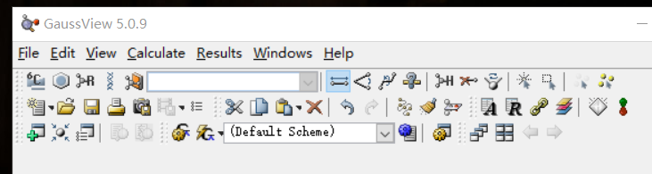
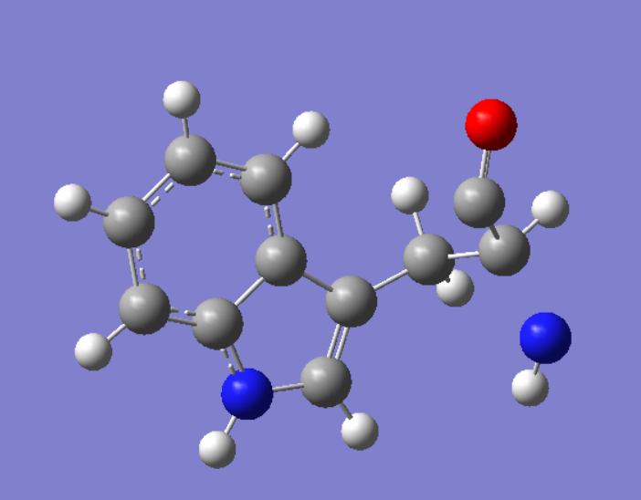
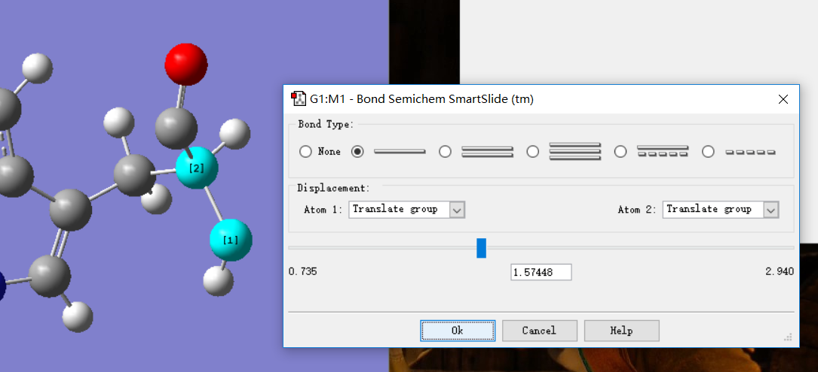
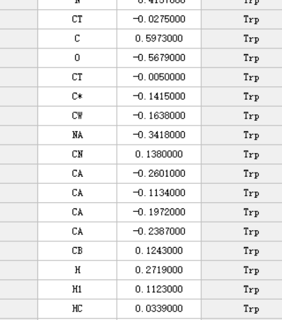
Gaussian: a tip
We find two atoms are not linked together.
Modify bond
Return to atom list, we find parameters are back!
Select atoms, bond order, OK.
BUT, a simple minimize in maestro would fix the problem, if you are not to strict about your coordinates.

Slide 14

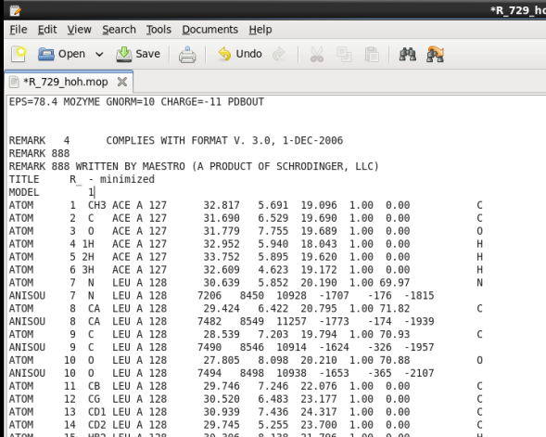
MOPAC: optimization
Read this!!!!!
http://openmopac.net/manual/index.html
In .bashrc
In a PDB file:
First line
EPS=78.4 MOZYME GNORM CHARGE=-11 PDBOUT
ε for water
A special tech to speed up calculation
Two blank lines or what ever you want to write. MUST ADD TWO LINES.
If no special keyword given, an optimization would be run.

Slide 15
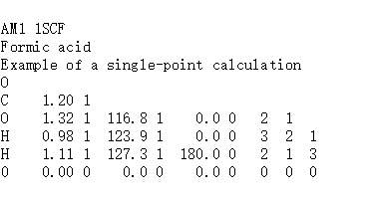

MOPAC: single point energy
Add keyword ‘1SCF’ would do the trick.
#!/bin/bash
#BSUB –q q2697vcpu
#BSUB –o /dev/null
#BSUB –e ./err
#BSUB –n 1
#BSUB –m c005
#BSUB –J “”
mopac xxx.mop
Change PDB file name to xxx.mop
Use commond
mopac xxx.mop to submit the job
Of course in a submit script
Can only run on a single processor!

Slide 16
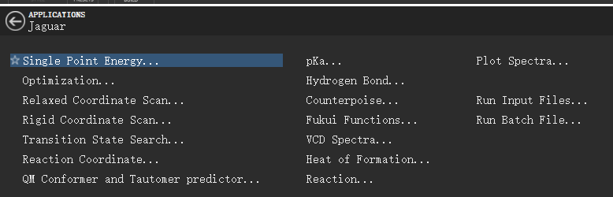
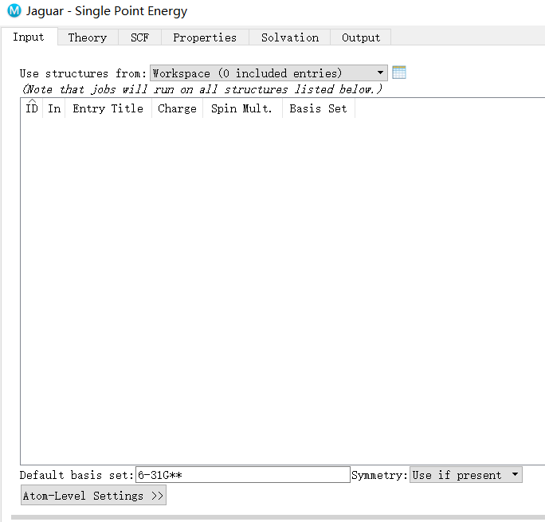
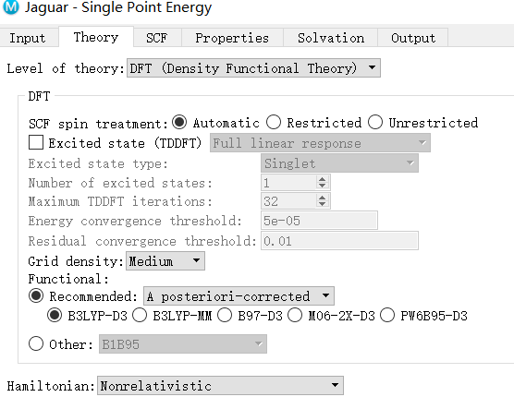
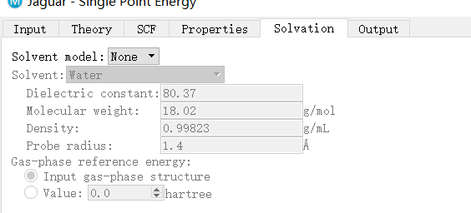
Jaguar
Basis set
method
RUN!
solvation

Slide 17
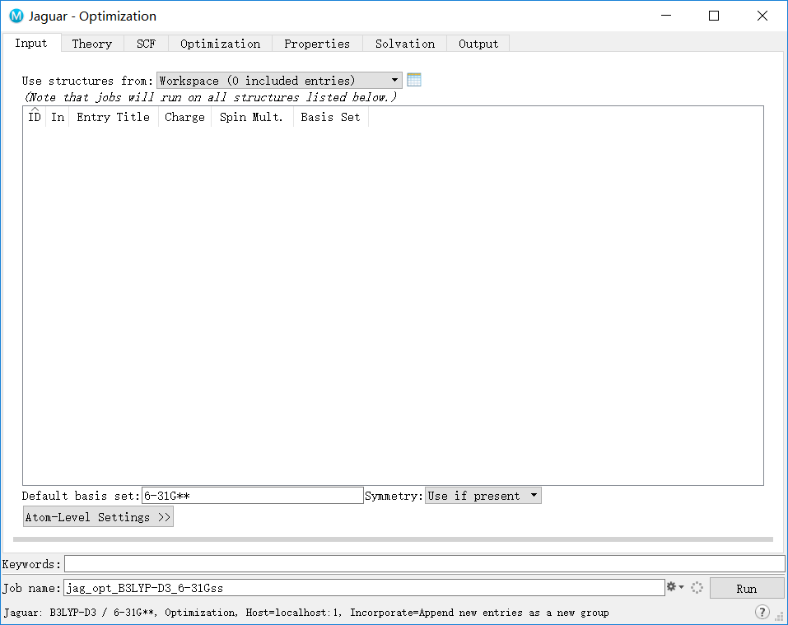
Jaguar
same

Slide 18
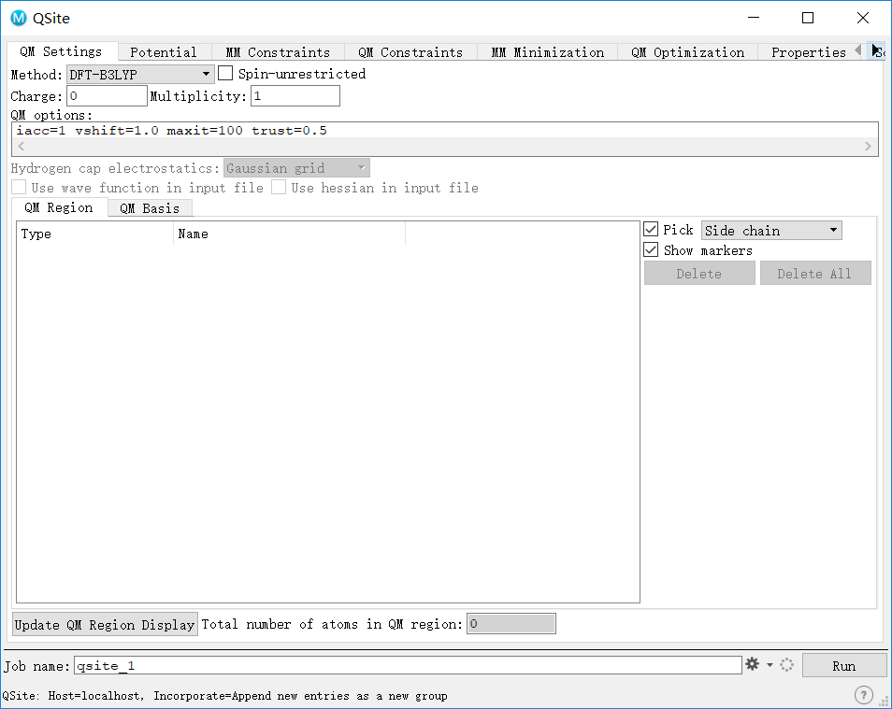
Qsite: QM/MM in maestro

Slide 19
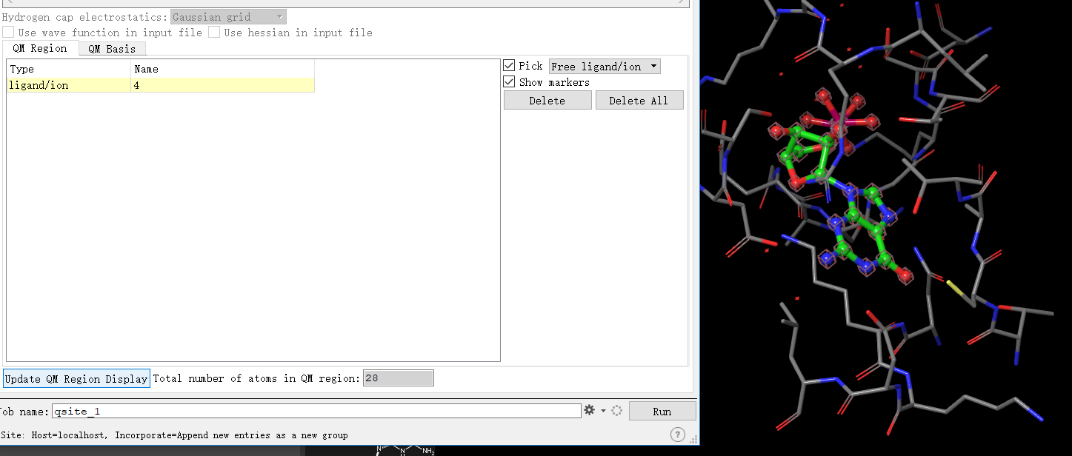
Qsite: define QM region
Pick Free ligand/ion
Select ligand
Update QM region

Slide 20
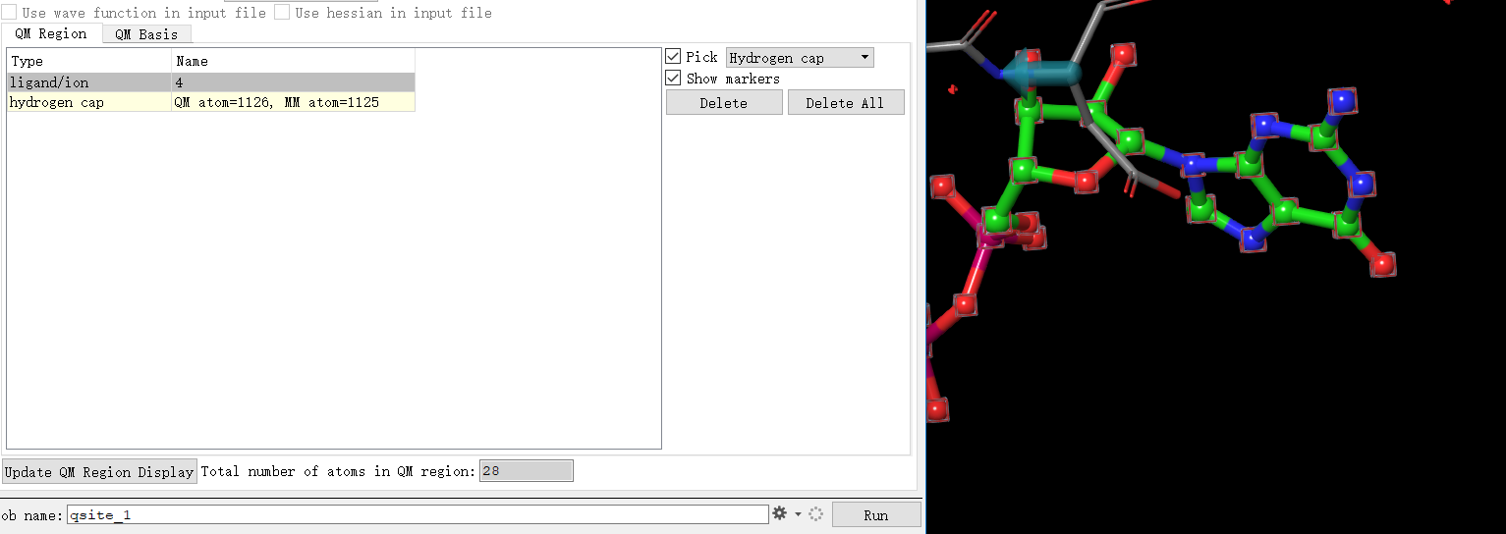
Qsite: define QM region
Add Hydrogen cap to define QM region.
Select two atoms, add a hydrogen cap between them.
Select atom closer to QM region first! You can see an arrow, start from QM region, point to MM region.
Add enough hydrogen cap to make sure only atoms you want are in QM region!!!

Slide 21
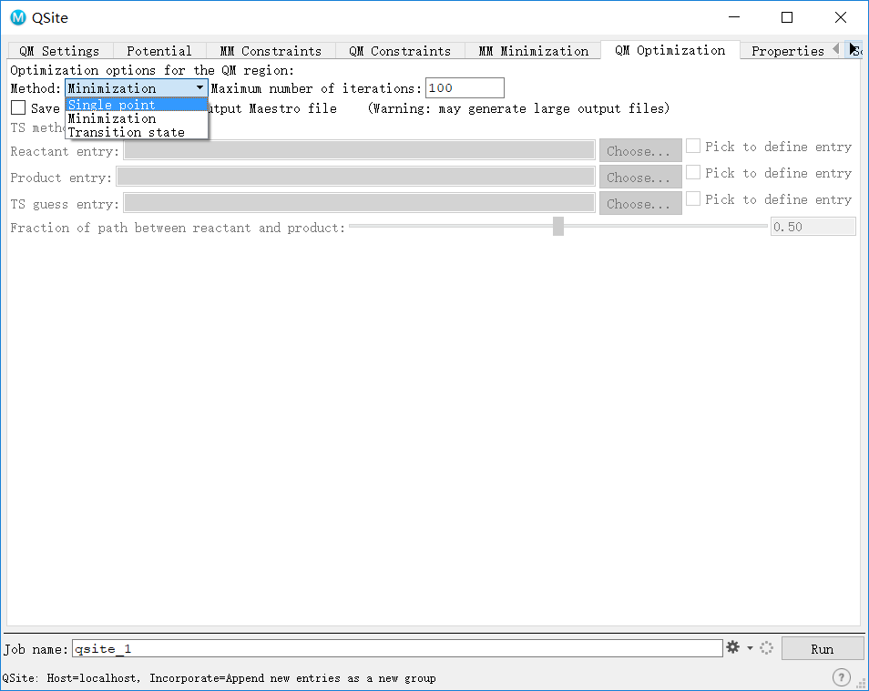
Qsite: minimization and single point
Select what you want

